Slide 1
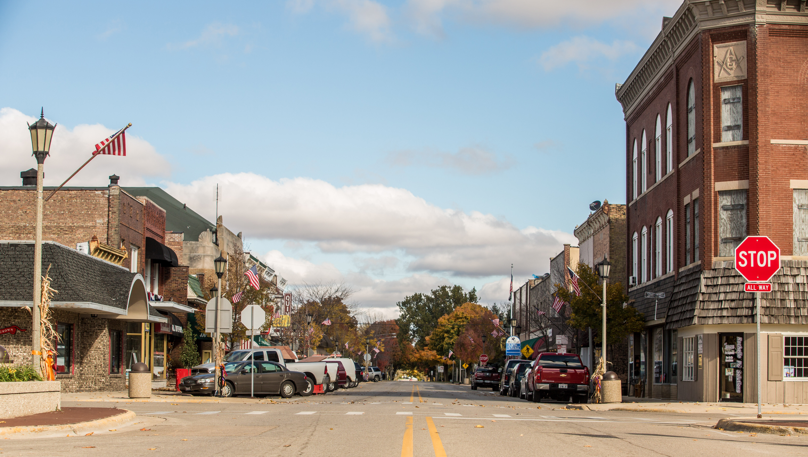
Downtown Building Improvement program

Slide 2
Purpose
Encourage and support building and business owner investment in their downtown retail/commercial buildings.
Small businesses often times get left out of incentives that are typically offered to larger businesses. Begin to include small business in these incentives.
Bring a greater sense of value and uniqueness to our downtown. It’s important that we assist both large and small businesses.
Incentives make things happen!

Slide 3
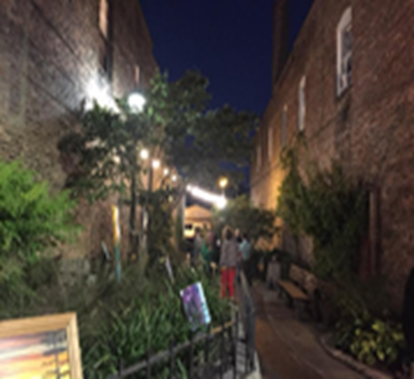
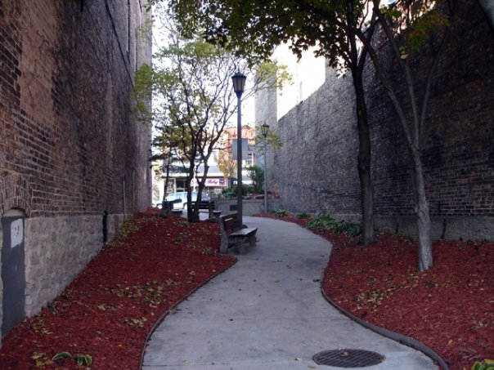
Potential Funding sources
Economic Development
Downtown & Southern Gateway TIF
Business owner matching funds

Slide 4
Eligibility & application process
Eligibility:
  Eligible applicants include the owner of a commercial/retail building or the owner of a commercial/retail business in Downtown Rochelle
  Business owners who are tenants of a Downtown Rochelle building must provide written consent from the building owner for all proposed improvements
Application Review Process:
  Aesthetic Improvement Value
  Extent/Scope of Work Proposed
  Potential Economic Impact

Slide 5
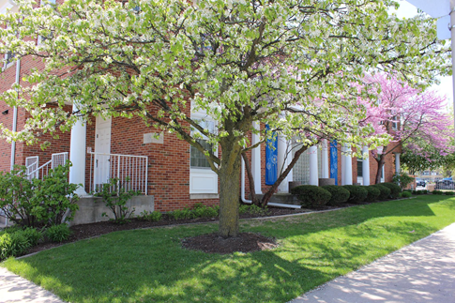
Potential eligible improvements
Brick Cleaning
Exterior Doors
Streetscape Elements
Tuck Pointing
Windows and Window Frames
Landscaping
Painting
Shutters and Awnings
Stairs, Porches, Railings
Wall Façade Repair & Treatment
Exterior Lighting
Roofs visible from the Street
Original Architectural Features repair or replacement
Signage Repair or Replacement
Improvements for ADA compliance
Ineligible Projects

Slide 6
Potential Ineligible projects
Funds for working capital, debt refinancing
Equipment/inventory acquisition
Application fees, permit fees, legal fees
Plumbing repair/improvements, HVAC repair/improvements
Parking lot resurfacing
Interior remodeling

Slide 7
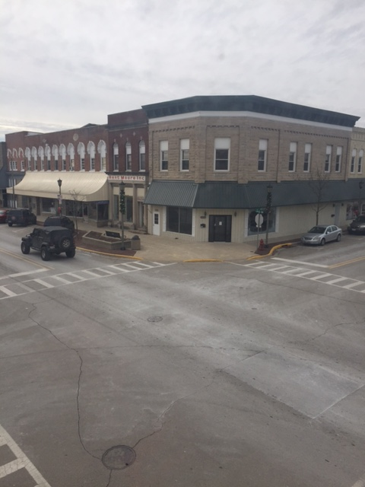
Next steps……..
Budget approval of allocated funds
Form Application Review Committee
Market the Building Improvement Program to Downtown businesses
Review applications
Make Downtown Rochelle even more Beautiful!

