Slide 1

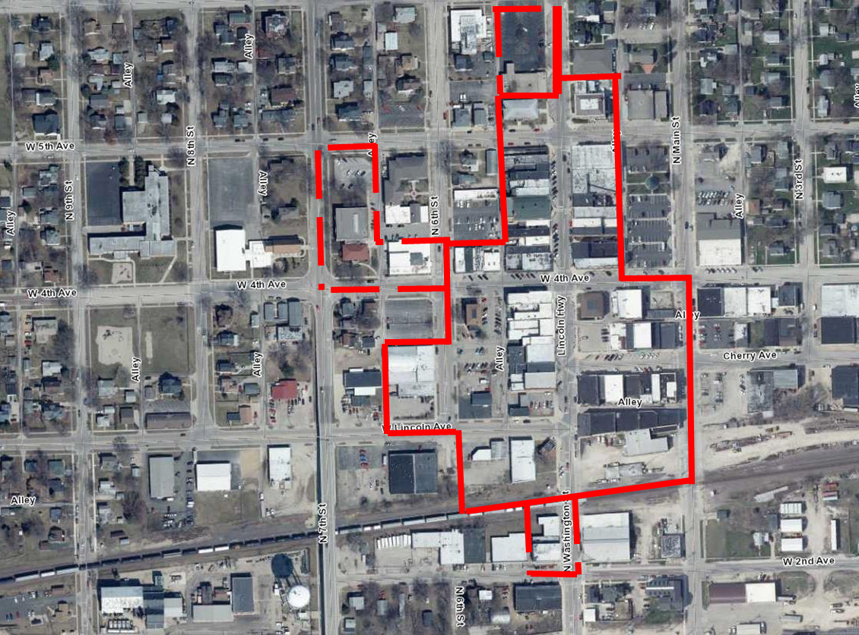
Rochelle downtown
Historic District

Slide 2
Benefits of a National Historic District
Tax Reform Act of 1986
20% federal income-tax credit on projects for owners historic buildings
Qualified expenditures may be subtracted directly from the owner’s federal income taxes
Housed in the National Park Service (NPS), the Historic Preservation Tax Credit program is administered in Illinois by the Illinois State Historic Preservation Office (IL SHPO)
Benefits Owner, Occupants and Community
Assists with financing gaps- cost of a rehabilitation project and return on investment
Encourages the preservation of historic buildings
Increases the value of rehabilitated properties
Returning underutilized structures to the tax rolls
Revitalization
Creates sustainability by reusing the existing environment

Slide 3
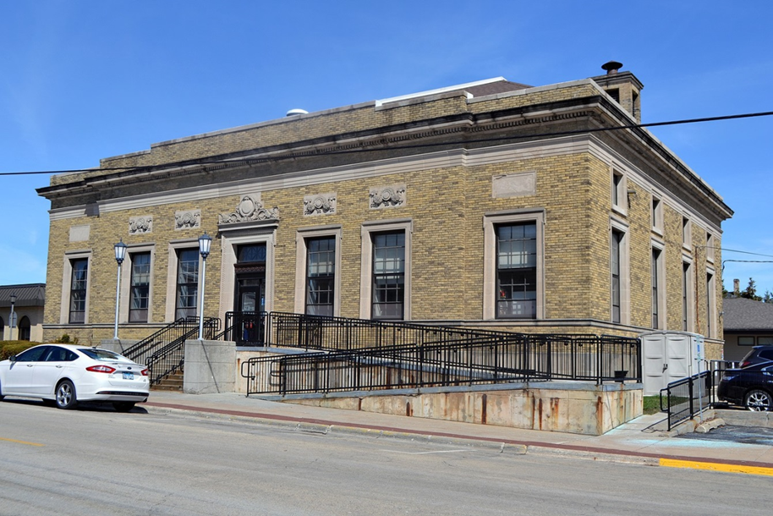
Our process……
  All downtown properties in a 2 block radius submitted for review……
…..verified addresses of all properties in the proposed district…65 total

Slide 4
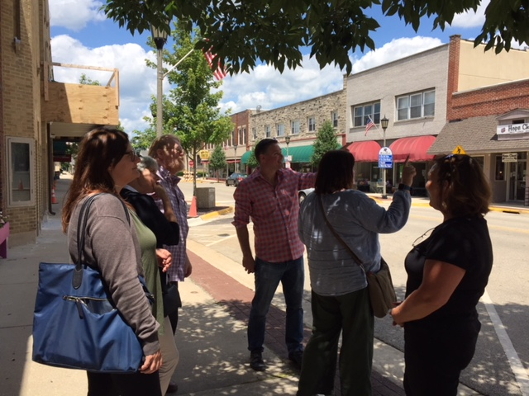
The Process continues....
Historical data on properties- City files & Flagg Township Historical Society data
Questionnaires to property owners
Letters of support
Site visits

Slide 5
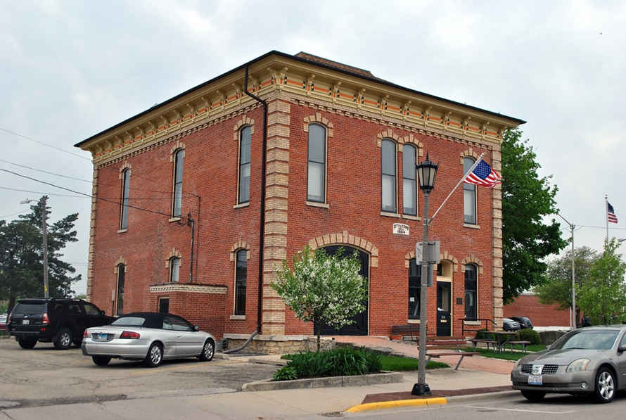
Request for Preliminary Determination of Eligibility Submitted
Properties in the 200 to 500 block of Lincoln Highway, 400 block of Cherry Avenue, 400 and 500 blocks of West 4th Avenue and 300 block of North 6th Street.
Constructed approximately in 1870s to 1960s, with majority of structures completed between 1870 and 1930.
The proposed district contains streetscapes of buildings that exemplify the history of Downtown Rochelle. The district’s boundaries focus on pre-1968 commercial and governmental buildings.

Slide 6
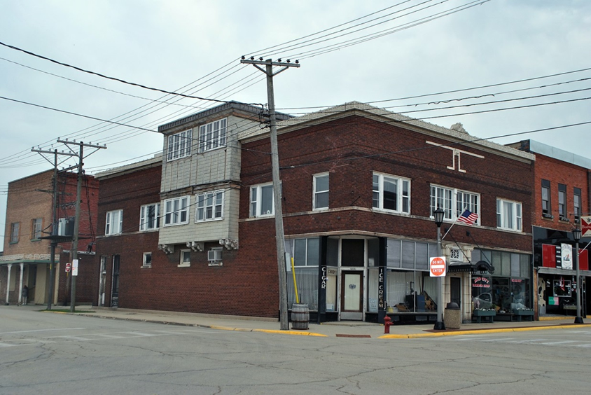
Rochelle Downtown Historic District
October 26th- Illinois Historic Sites Advisory Council (IHSAC) reviewed and recommended the nomination to be sent to National Park Service staff in Washington, D.C. for final review
Final review takes approximately 2 months
Listed on the National Register January 2019
Begin to promote to developers

