Slide 1

Public Safety Pension Funding
Jeff fiegEnschuh, City Manager

Slide 2

PENSIONS 101:
Downstate Police & Fire Pension Fund
40 ILCS 5/3 & 5/4-125
State statute-required benefits for eligible municipal public safety employees in municipalities with 5,000 - 500,000 citizens
Firefighter employee contribution = 9.455% of salary
Police employee contribution = 9.91% of salary
  Note: Employee contribution for Social Security & Medicare = 7.65%
  Police and Firefighters don’t receive Social Security benefits on their income derived from public safety
All employee benefit levels are set by state statute not at the local level.
Employer contribution based on investment returns, actuarial analysis and changing benefit levels
IL Constitution prohibits diminishing of pension benefits. All benefit levels and employee contribution levels are set by the state of IL.
City levies the property tax and upon receipt the appointed pension board oversees the investment. Per state statute only certain investments are able to be made.

Slide 3
PENSIONS 101:
Sources of Funding
Funded primarily through property taxes (since the great recession property values have not kept up with increasing obligations). The only sources of revenue for funding pensions are employee and employer contributions along with investment earnings.
The City of Rochelle general fund revenues have seen slight increases. While overall EAV has been steadily increasing, residential property values have remained flat.
Based on current rate of return and updated actuarial assumptions, the average annual increase for contributions is 3%-5%. Must be funded 90% by 2040.
IMRF, Police and Fire pensions are listed as a Long-Term Debt on the City’s balance sheet. Unfunded portion of $11,068,488 for police and fire as of most recent audit. The unfunded portion does not include the annual cost. This is the cost of an active members participation in the pension fund. If the fund were 100% funded, we would still have this cost as we progress forward.

Slide 4
Most Property Types have Increased in Value in Recent Years

Slide 5
Residential Property Values are Starting to Increase

Slide 6
City of Rochelle Tax Levy Through Fiscal Year 2017

Slide 7
2019-2041 Projected Required Contribution
 | (1) Assumes actuarially projected results are achieved.
_____________________
(1) Assumes actuarially projected results are achieved.

Slide 8
Summary of the City’s Police and Firefighters’ Pension Plans
The City’s Police and Firefighters’ Pension Plans had the following characteristics as shown in the City’s 12/31/17 Comprehensive Annual Financial Report:
City of Rochelle has unfunded Police pension liabilities of approximately $5.986 million.
City of Rochelle has unfunded Firefighters’ pension liabilities of approximately $5.082 million.
Combined funding level of 61%, (statewide average for downstate pension plans is 57.58% )
Police Pension plan funded at 94.2% on 4/30/09, Fire Pension plan funded at 92.7% on 4/30/07.
The pension funds assumed rate of return is 6.75%, which is used to calculate annual contributions. Lower ROR means higher annual payments.

Slide 9
City Fiscal Responsibility & Staff Recommendation
Historically, the City has funded 100% of the city’s actuarial recommended levels. The State DOI also provides recommendations, but typically lower.
Jan 1,2018 actuary report recommended City’s portion of the fire pension funding level be $482,180 (This includes the normal contribution and the unfunded liability). This represents a $17,192 increase over the previous year.
Jan 1, 2018 actuary report recommended City’s portion of the police pension funding level be $614,329 (This includes normal contribution and unfunded liability). This represents an increase of $56,455 from the previous year.
Staff Recommends beginning in 2020, the City Council reallocate all gaming revenues to the police & fire pension funds
    $140,000 budgeted in current FY. This amount will be split evenly between the pension funds.
    This amount will be above and beyond the annual amount levied based on the actuarial recommendations.
    These funds will be utilized to buy down the unfunded liability.

Slide 10
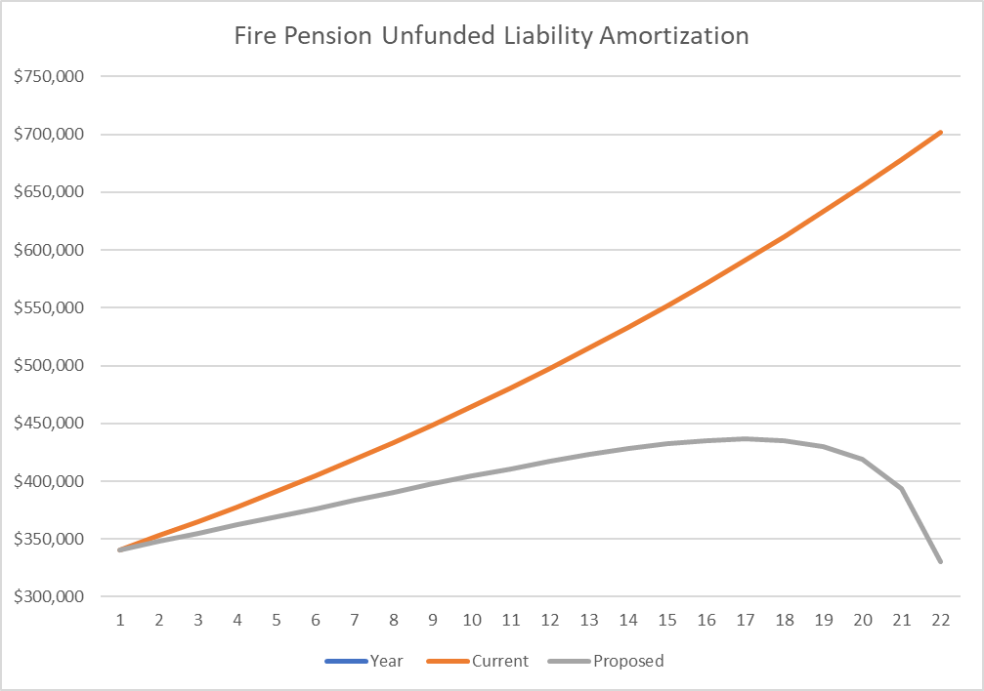
Funding Options- Fire Pension

Slide 11
Funding Options-Police Pension

Slide 12
City of Rochelle
Rochelle’s Standard & Poor’s bond rating is AA
Received Certificate of Achievement for Excellence in Financial Reporting since 2015
Contact Jeff Fiegenschuh with any additional questions at 815-561-2000

