Slide 1
WATER RECLAMATION DIVISION
AND
WATER DIVISION
RATE STUDY SUMMARY
UAB MEETING
NOVEMBER 13, 2019

Slide 2
Presentation Outline
Water/Water Reclamation Infrastructure Photos
Water Division Budget
Water Division Capital Projects
Water Division Rates
Water Reclamation Budget
Water Reclamation Capital Projects
Water Reclamation Rates
Cost Impact to Users

Slide 3
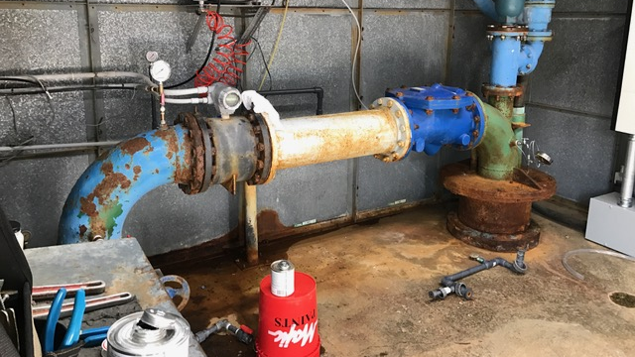
Old Well 10 Piping

Slide 4
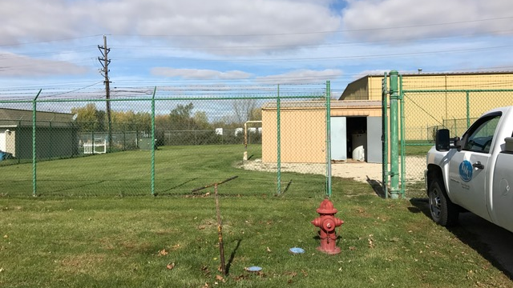
Old Well 10 Building

Slide 5
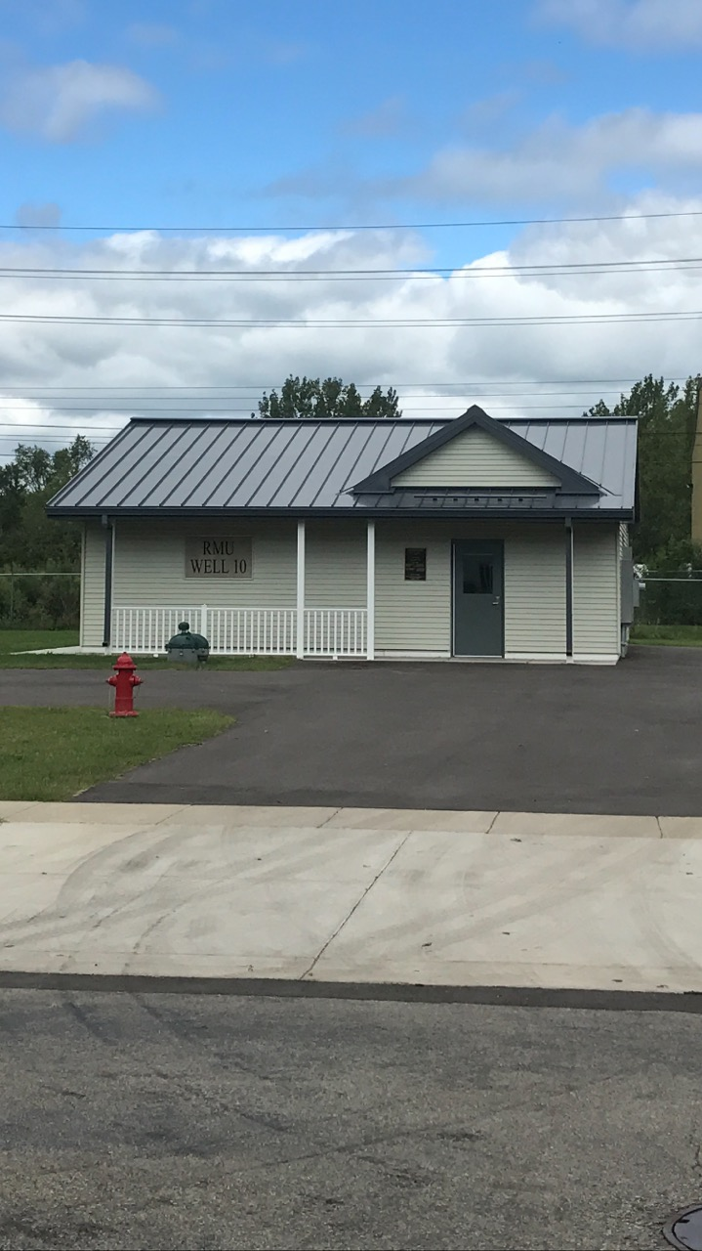
New Well 10 Building (2019)

Slide 6
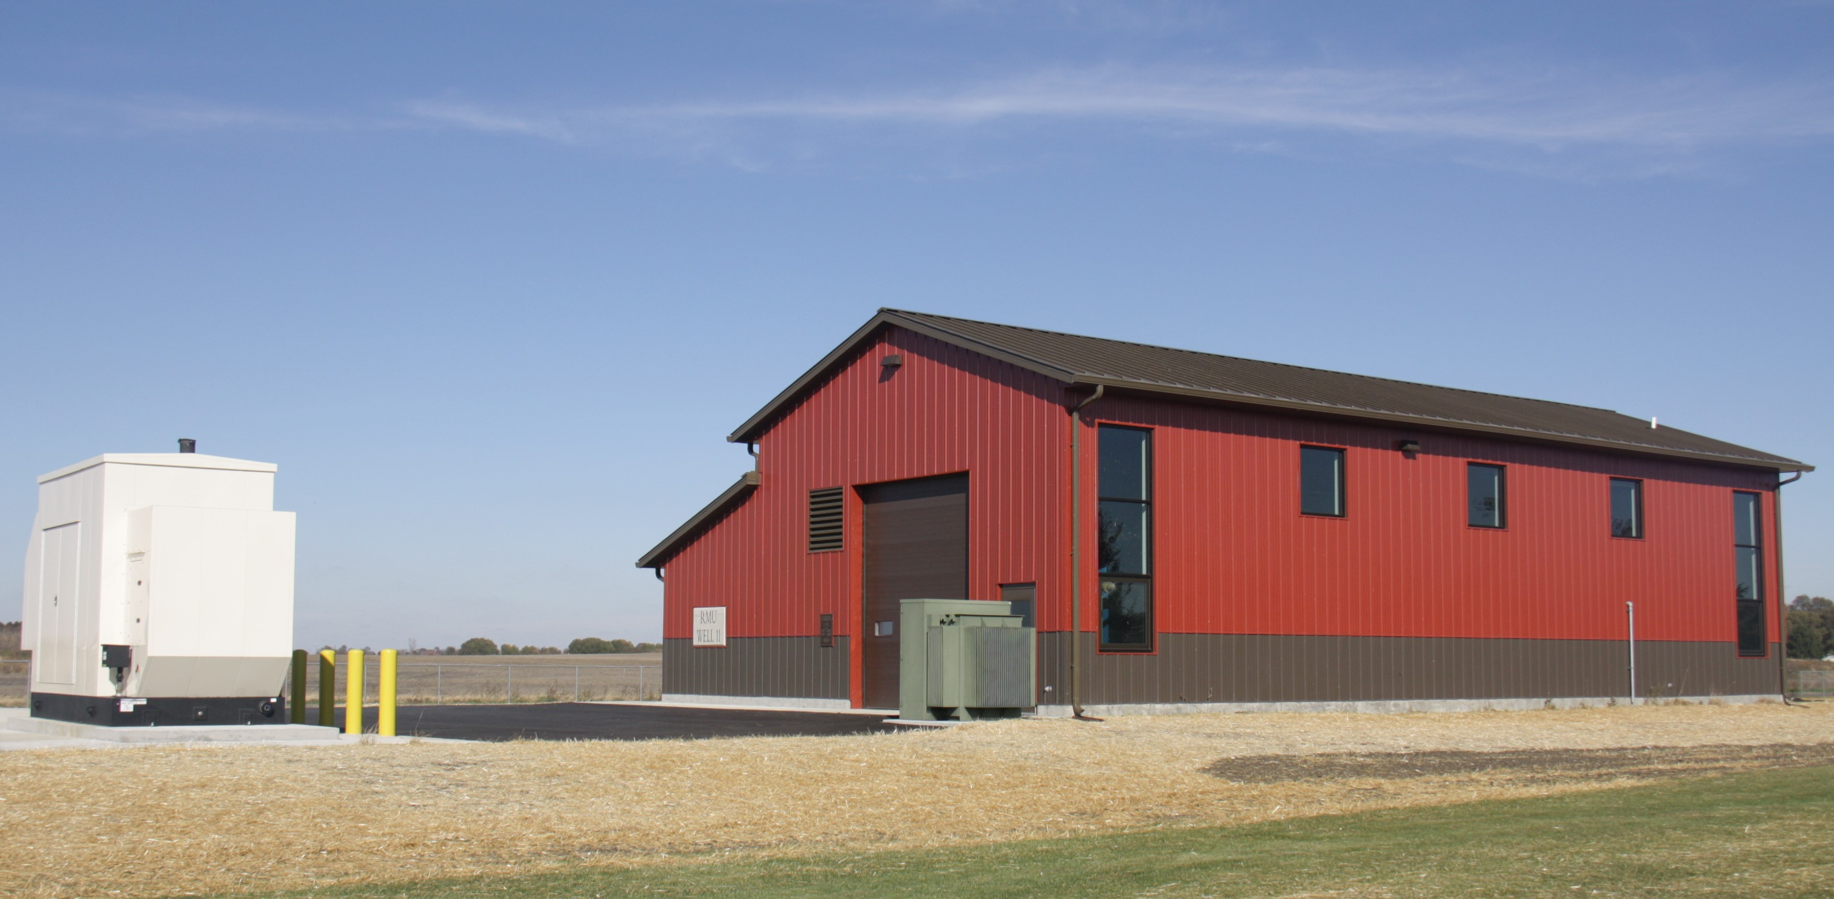
Well 11 Radium Treatment Plant (2018)

Slide 7
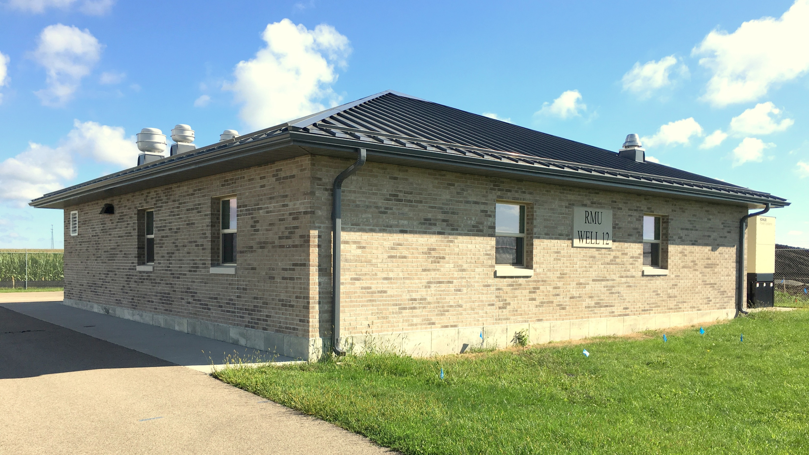
Well 12 and Well Building (2017)

Slide 8
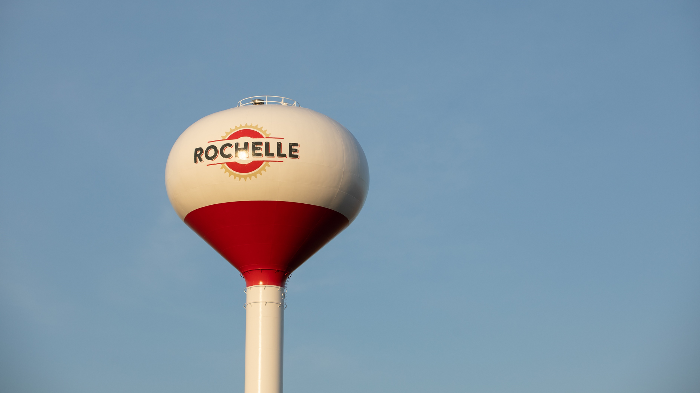
Well 12 Elevated Storage Tank (2017)

Slide 9
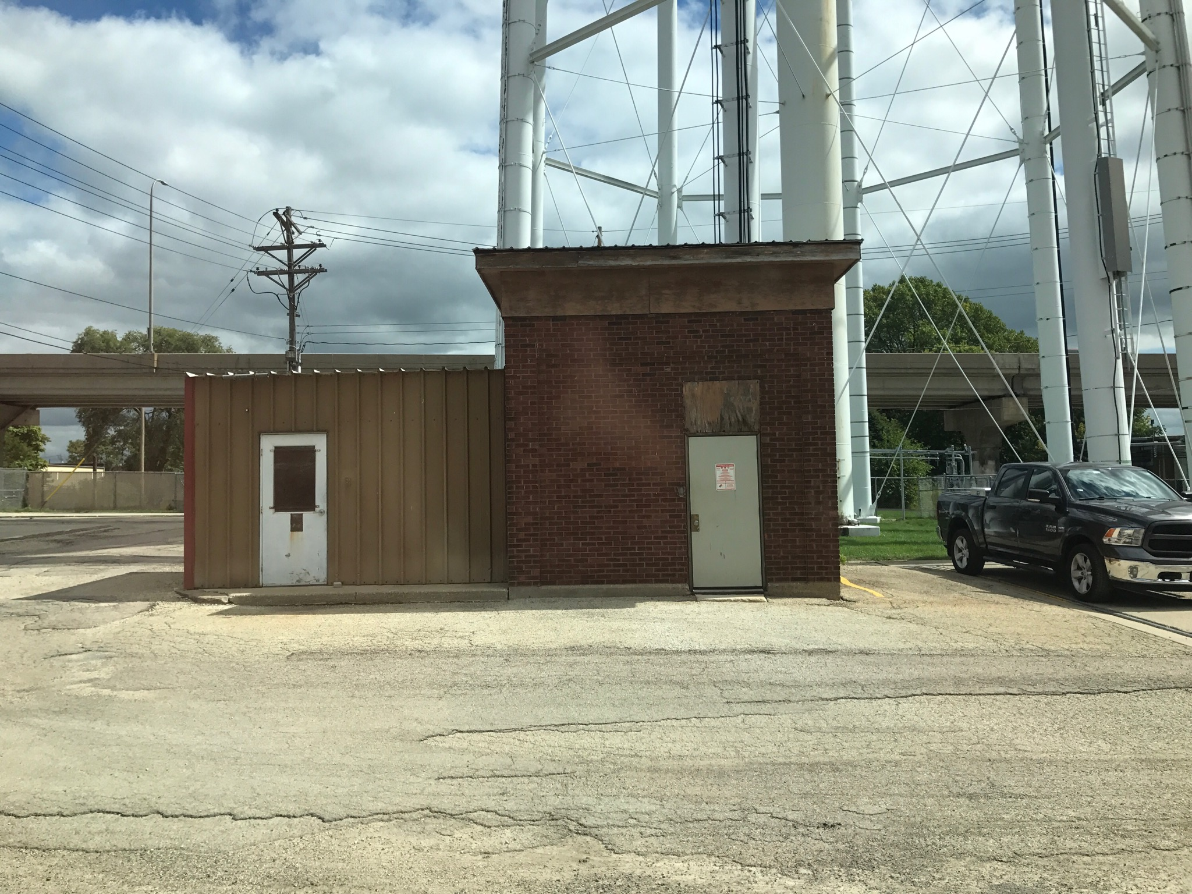
Well 4 Building

Slide 10
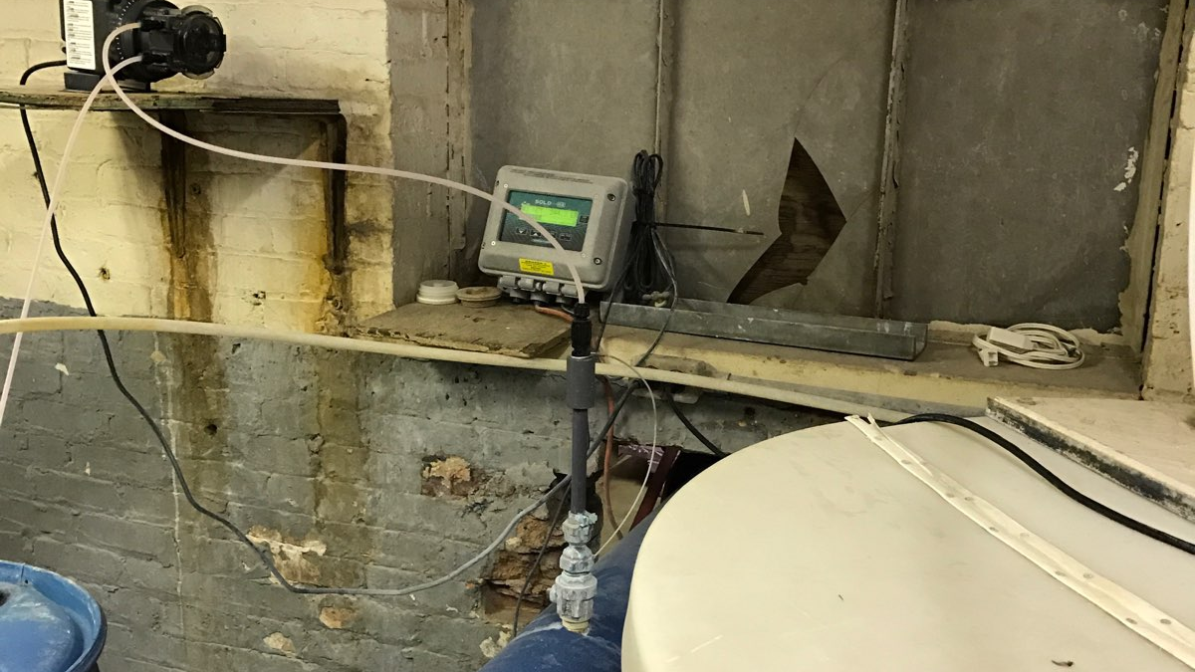
Well 4 Building Interior

Slide 11
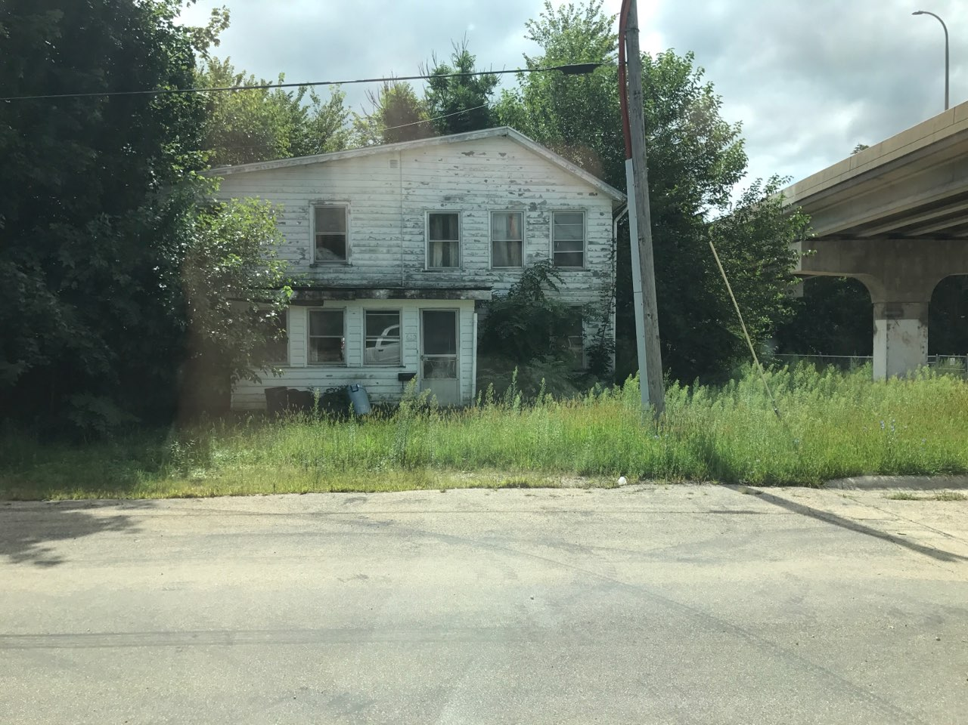
New Well 4 Building Site

Slide 12
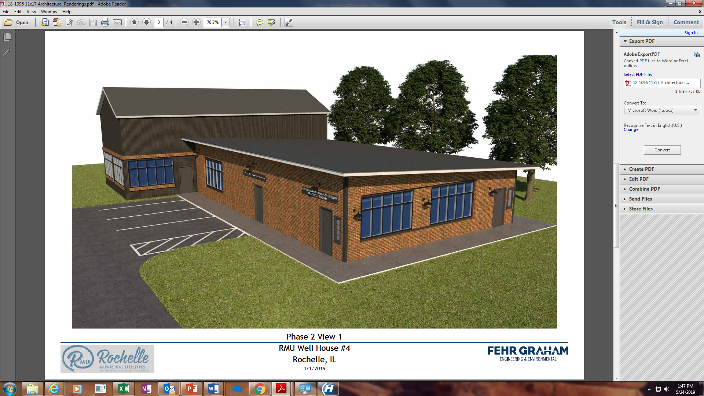
Proposed Well 4 Building (2020)

Slide 13
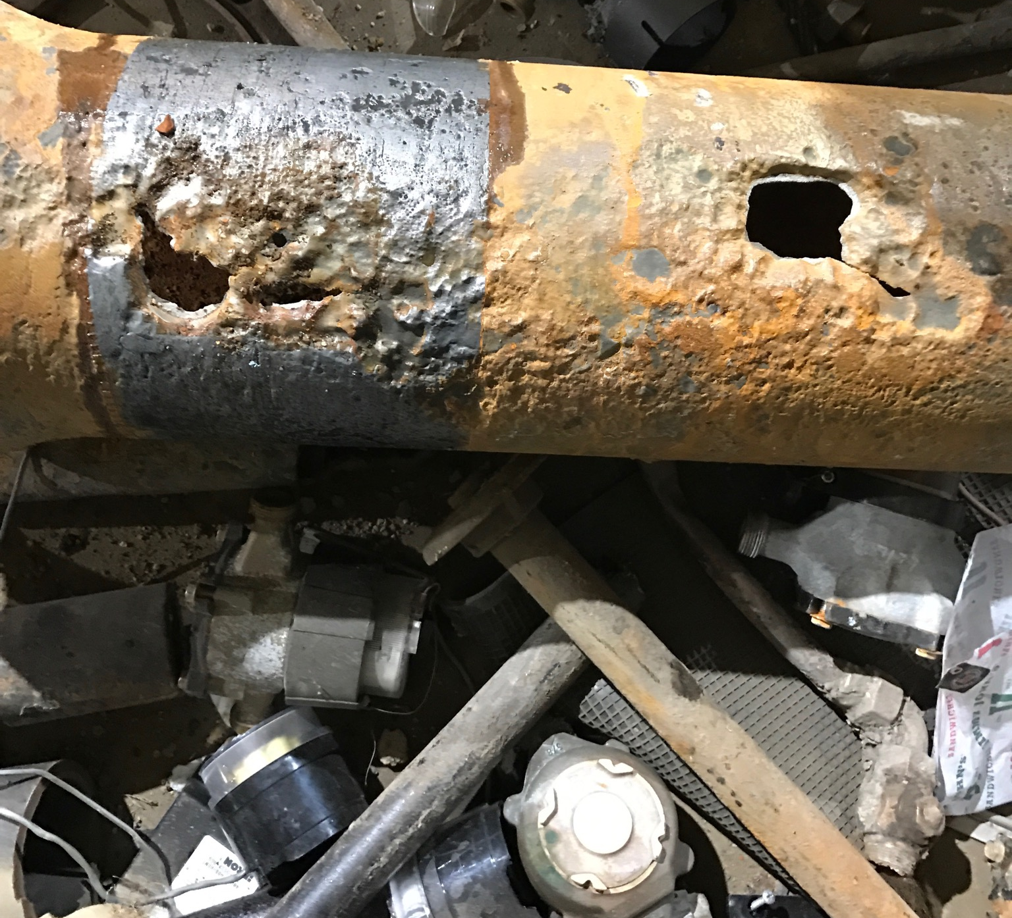
Water Main Break

Slide 14
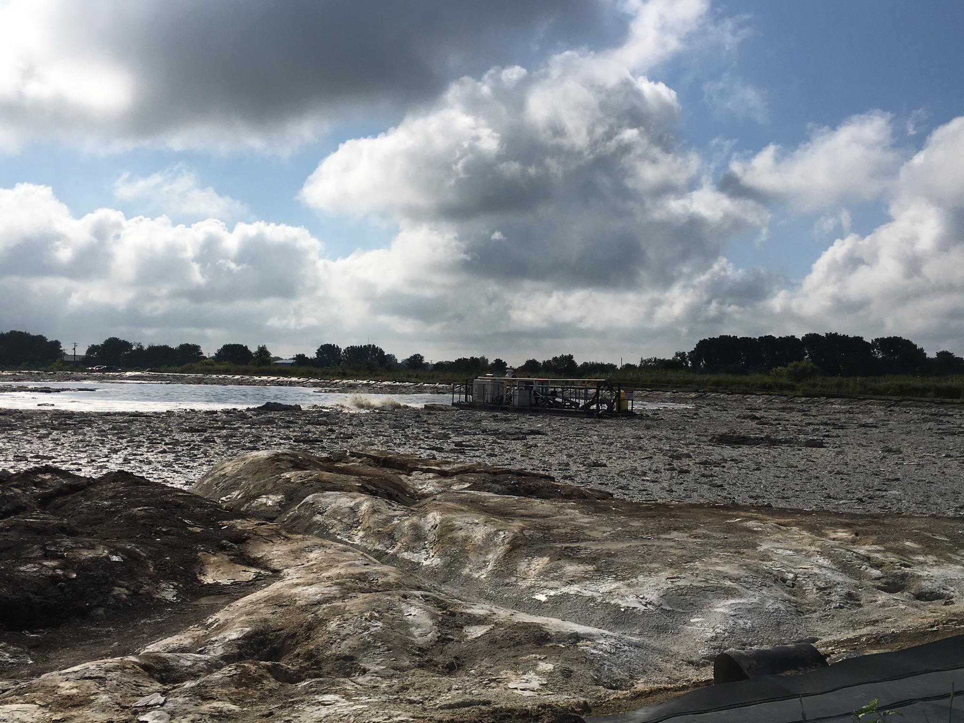
Anaerobic Lagoon Rehabilitation (2019)

Slide 15
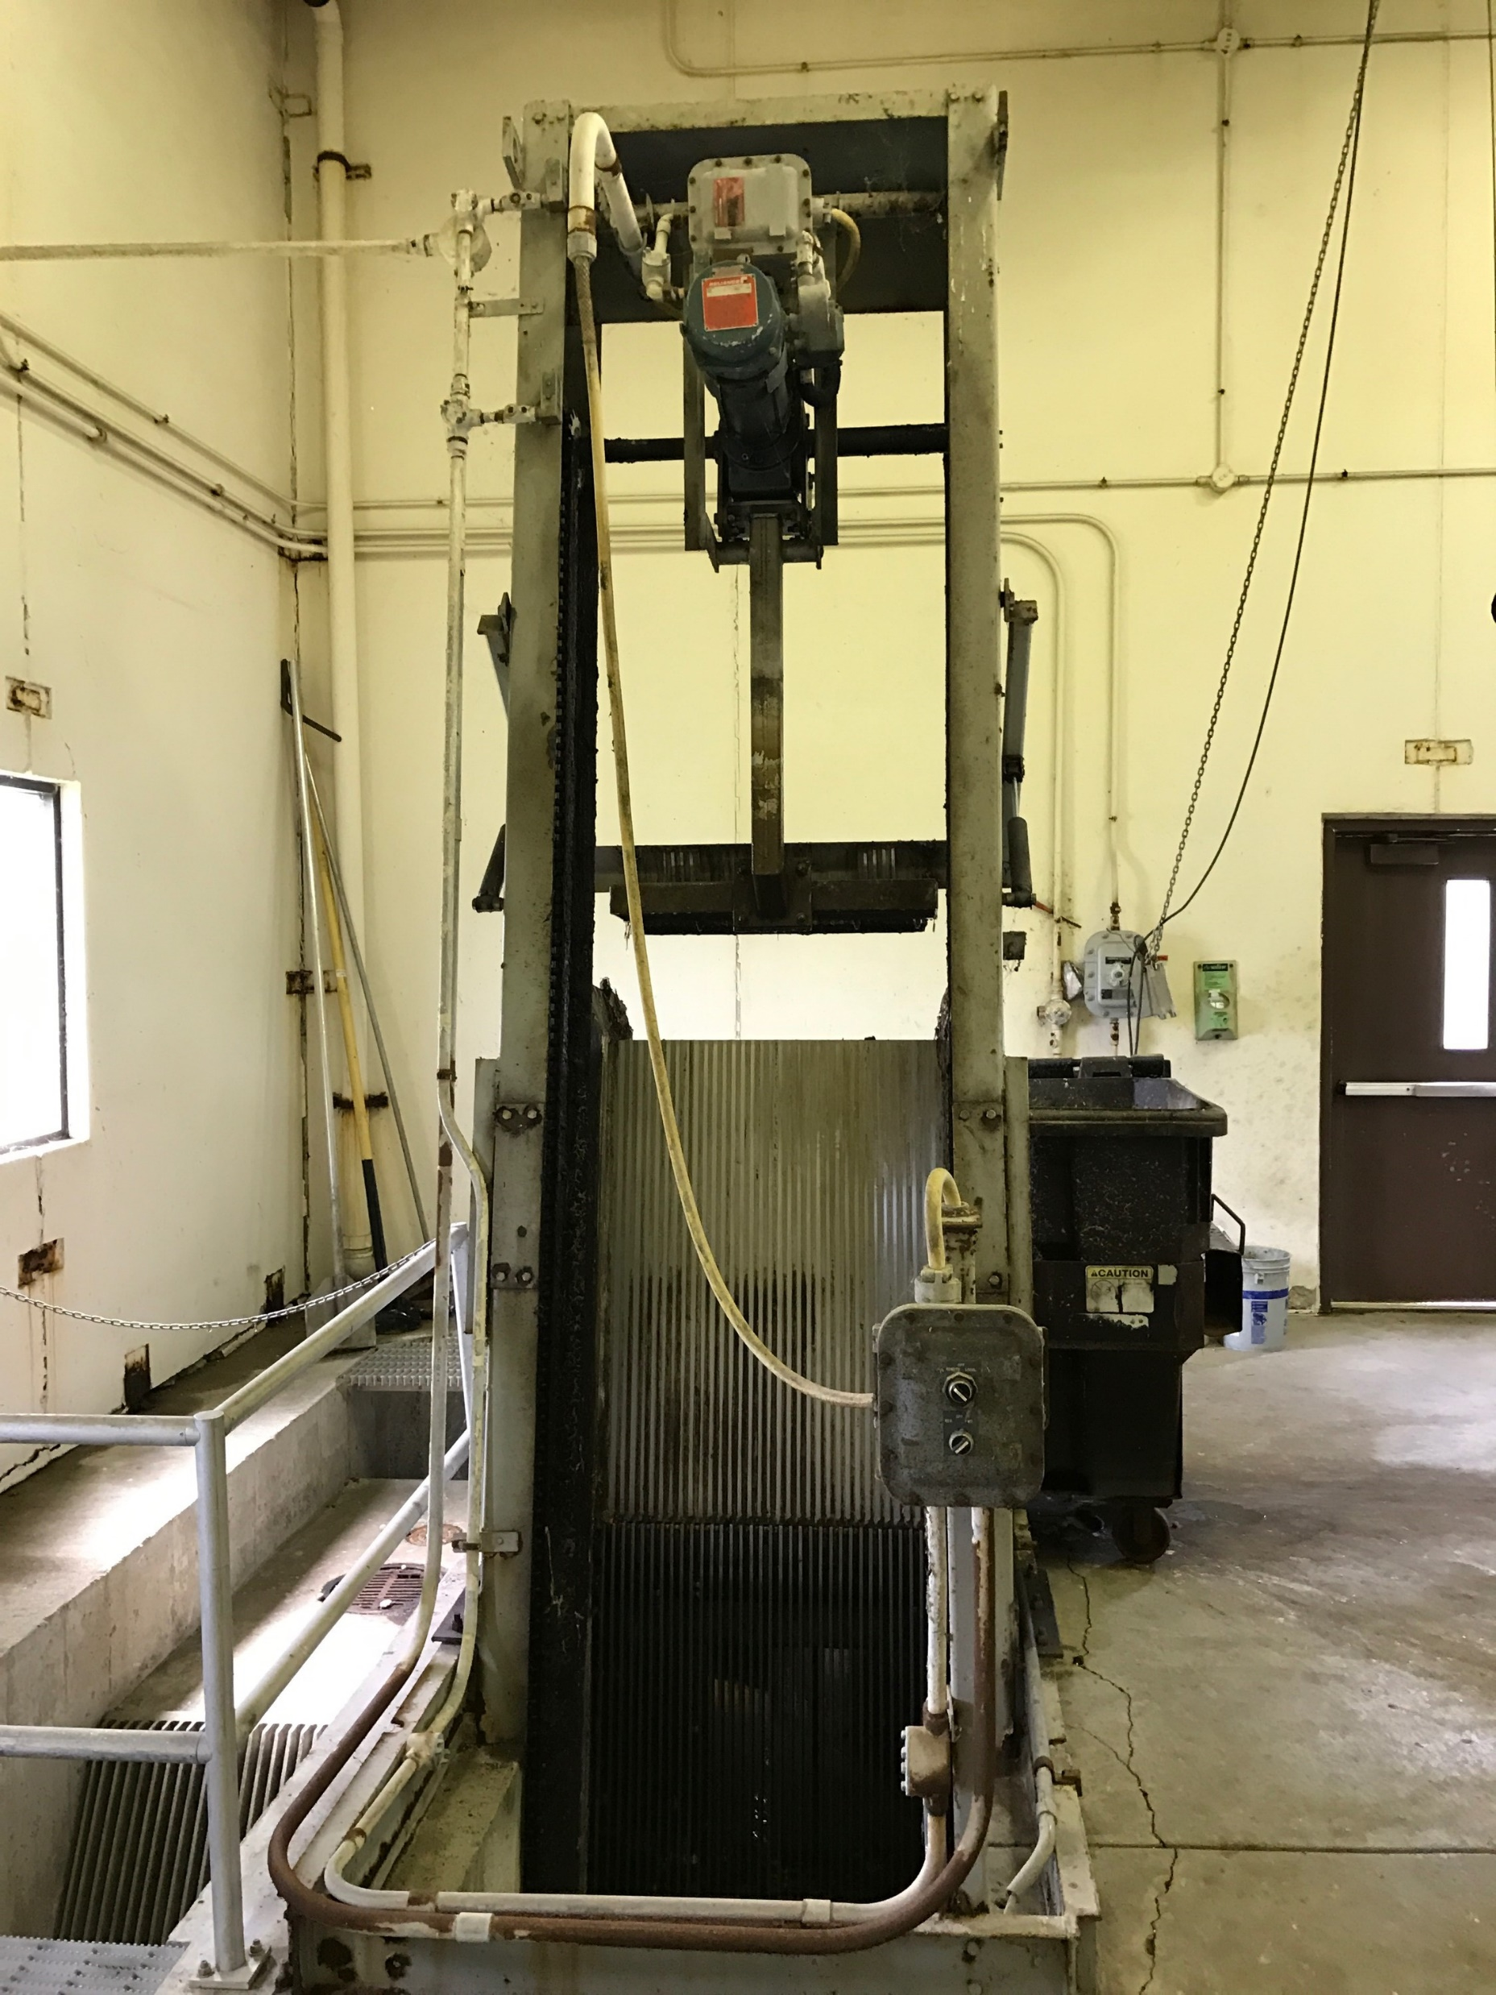
Headworks Building
Bar Screen Replacement (2019)

Slide 16
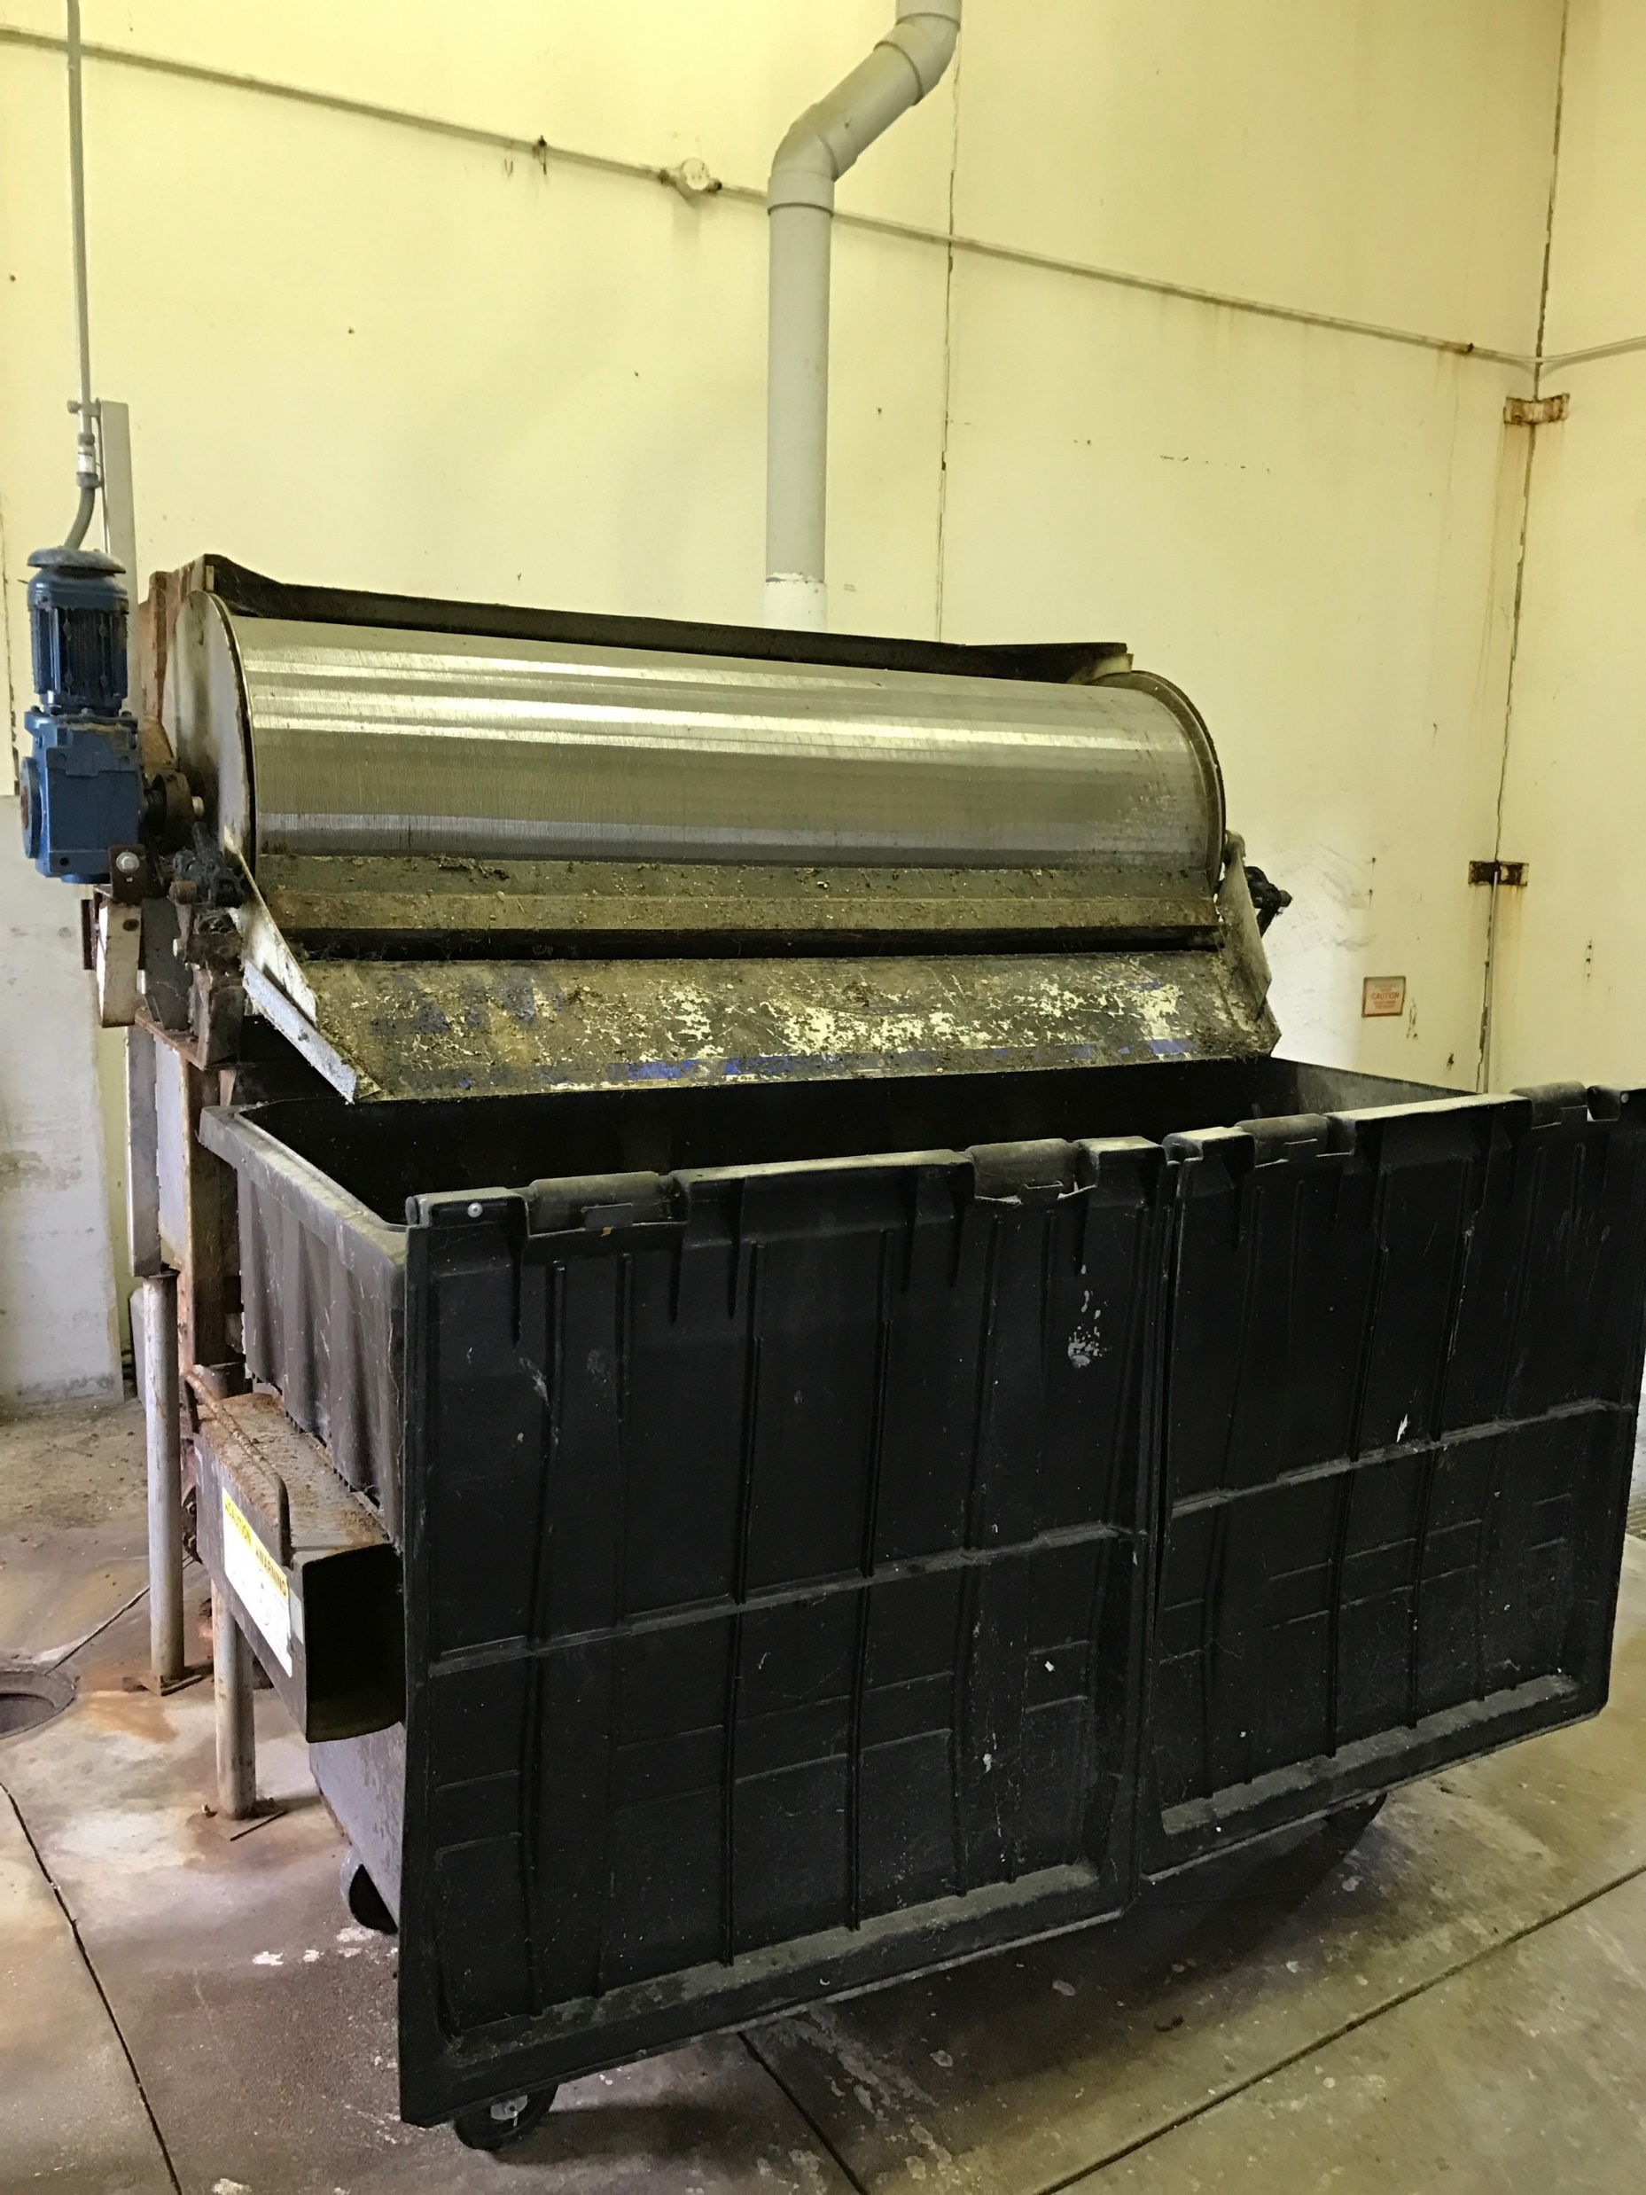
Headworks Building
Grit Washer Replacement (2019)

Slide 17
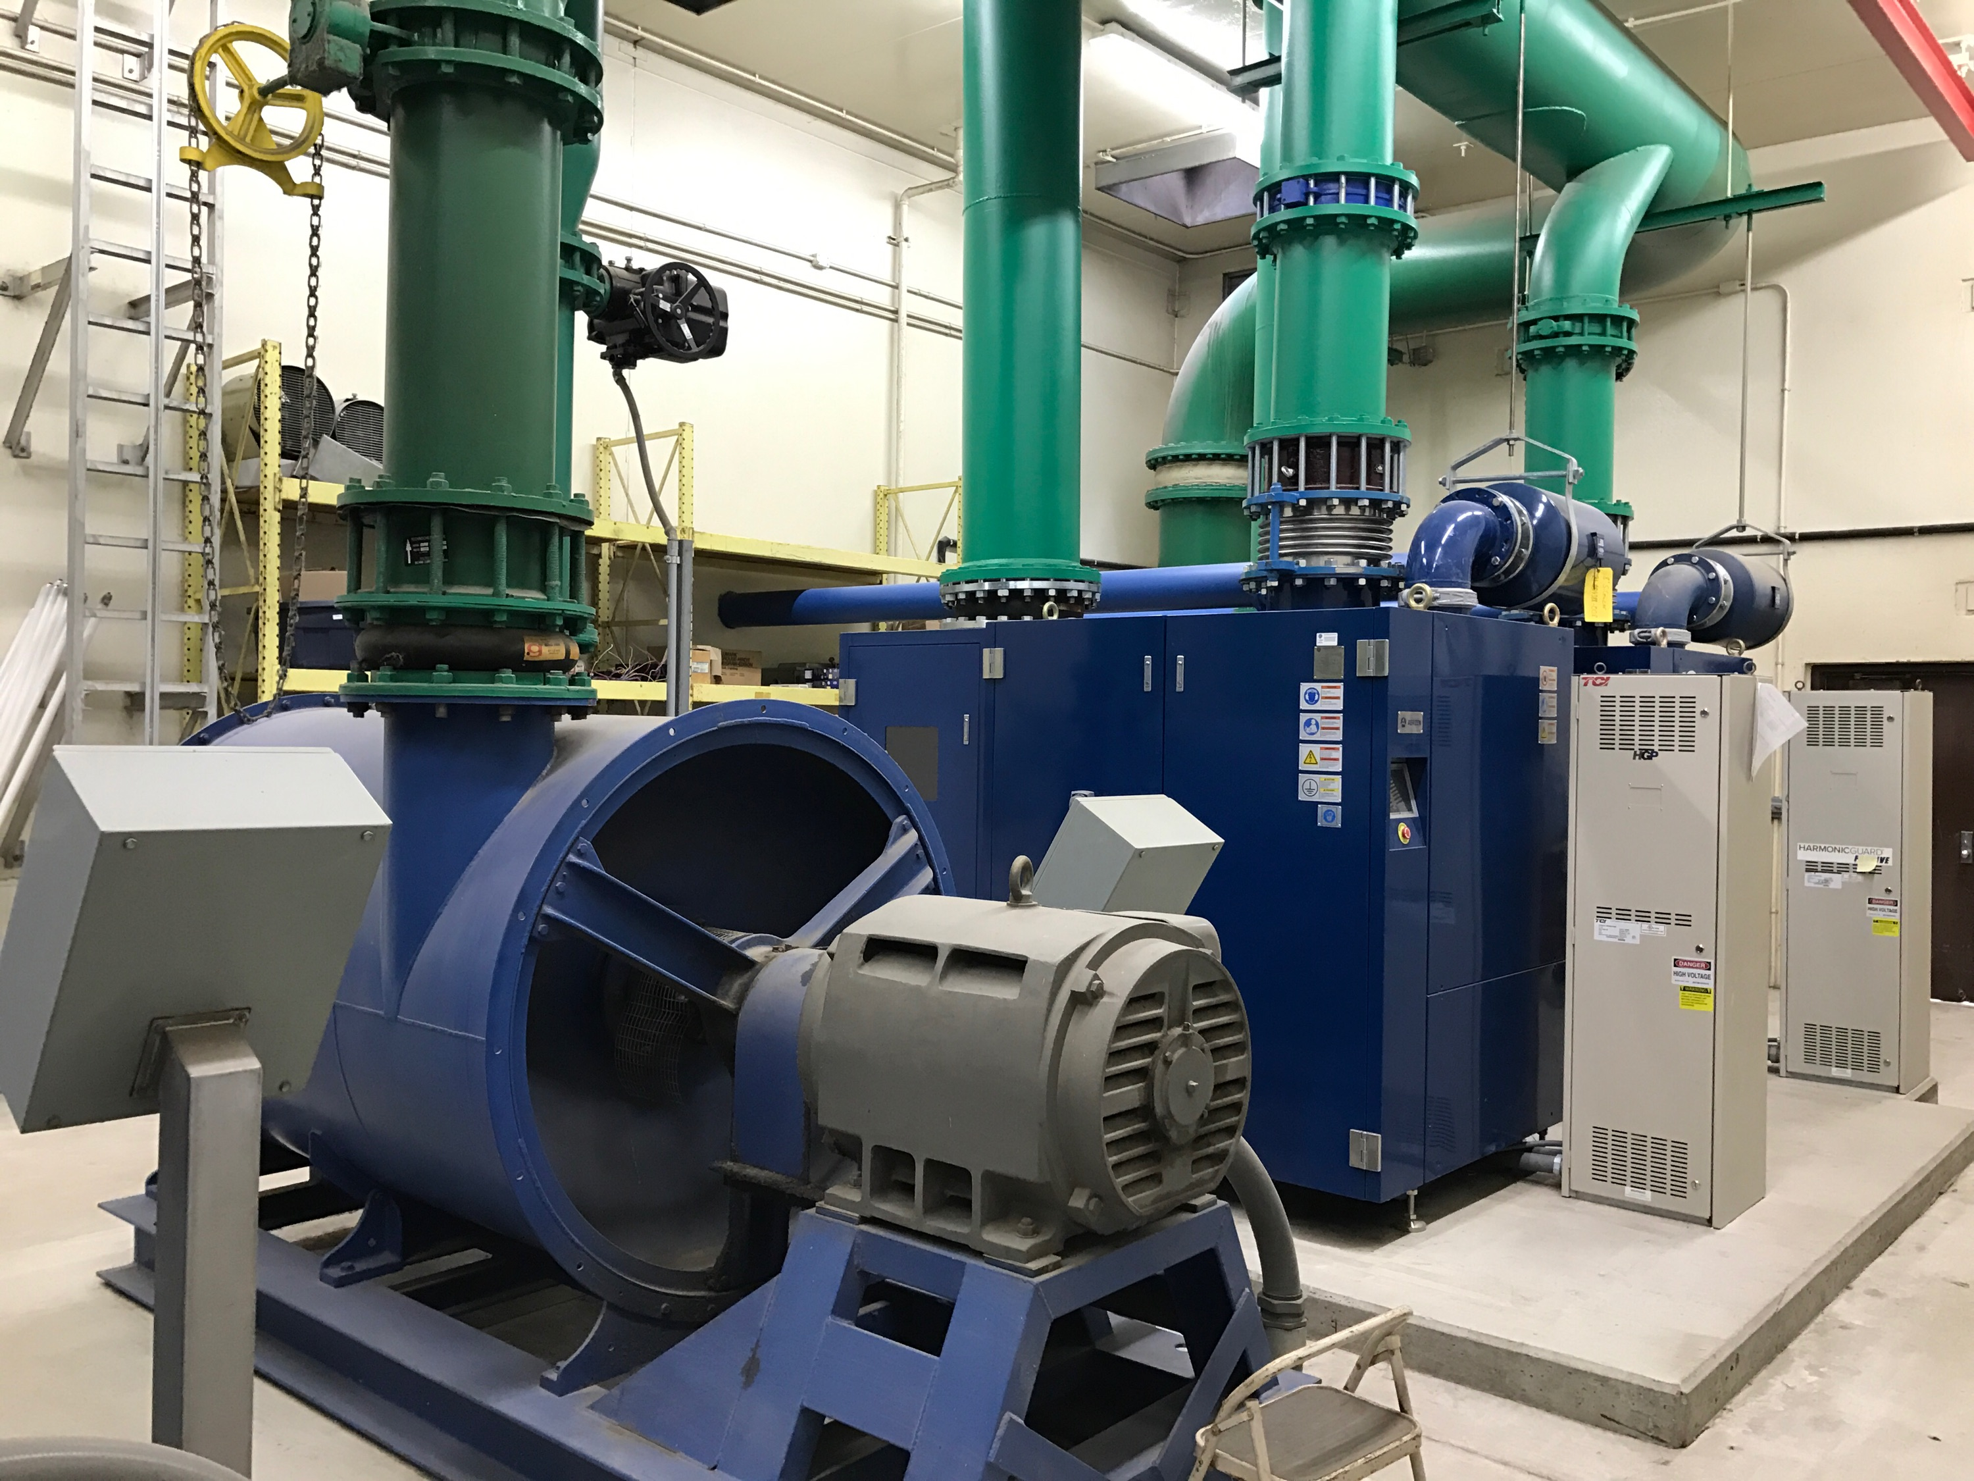
New Turbo Blower (2019)

Slide 18
Water Division Budgets
 | CY 2019 | CY 2020 | CY 2021 | CY 2022 | CY 2023 | CY 2024
Expenditures
Fixed Charge Expenses | $ 365,000 | $ 372,925 | $ 381,048 | $ 389,374 | $ 397,909 | $ 406,663
Basic User Expenses | $1,363,000 | $1,432,275 | $1,487,675 | $1,529,246 | $1,572,038 | $1,614,483
Equipment Replacement Expenses | $ 133,400 | $ 133,400 | $ 133,400 | $ 133,400 | $ 133,400 | $ 133,400
Non-Debt Funded Projects Expenses | $2,425,000 | $4,849,000 | $ 453,000 | $ 440,000 | $1,572,038 | $1,020,000
Capital Recovery Expenses – Debt Service | $ 446,000 | $ 494,000 | $ 542,000 | $ 542,000 | $ 542,000 | $ 542,000
Total Expenditures | $4,732,400 | $7,281,600 | $2,997,123 | $3,034,020 | $4,155,346 | $3,713,159
Revenues
Water Sales | $2,434,386 | $2,861,732 | $3,177,122 | $3,291,319 | $3,427,518 | $3,564,219
Other Revenue | $ 162,000 | $ 162,000 | $ 162,000 | $ 162,000 | $ 162,000 | $ 162,000
IEPA Loan Reimbursements | $2,100,000 | $2,850,000 | $ 0 | $ 0 | $ 0 | $ 0
Cash Reserves | $ 0 | $1,450,000 | $ 0 | $ 0 | $ 0 | $ 0
Total Revenue | $4,696,386 | $7,323,732 | $3,339,122 | $3,453,319 | $3,589,518 | $3,726,219
Net Income/(Loss) | ($ 36,014) | $ 42,132 | $ 341,999 | $ 419,299 | ($ 565,828) | $ 13,060

Slide 19
Water Division Capital Projects
Well 4 Well Building (2020)
Well 12 Radium Treatment Plant (2020)
Well 4 Elevated Tower Rehabilitation (2023)
Water Main Replacement Projects (2023 and 2024)

Slide 20
Water Division Rate Schedule
 |  | 2019 |  | 2020 |  | 2021 |  | 2022 |  | 2023 |  | 2024
 |  | 1st Tier | 2nd Tier | 1st Tier | 2nd Tier | 1st Tier | 2nd Tier | 1st Tier | 2nd Tier | 1st Tier | 2nd Tier | 1st Tier | 2nd Tier
Fixed Charge | $/User/Month | $ 10.45 |  | $ 9.35 |  | $ 9.57 |  | $ 9.80 |  | $ 10.03 |  | $ 10.27
Basic User Charge | $/HCF | $ 1.56 | $ 0.40 | $ 2.22 | $ 0.59 | $ 2.30 | $ 0.59 | $ 2.39 | $ 0.59 | $ 2.46 | $ 0.59 | $ 2.54 | $ 0.59
Equipement Replacement | $/HCF | $ 0.09 | $ 0.09 | $ 0.12 | $ 0.12 | $ 0.12 | $ 0.12 | $ 0.12 | $ 0.12 | $ 0.12 | $ 0.12 | $ 0.12 | $ 0.12
Non-Debt Funded Projects | $/HCF | $ 0.98 | $ 0.25 | $ 1.35 | $ 0.07 | $ 2.10 | $ 0.07 | $ 2.18 | $ 0.07 | $ 2.32 | $ 0.07 | $ 2.46 | $ 0.07
Capital Recovery | $/HCF | $ 0.43 | $ 0.30 | $ 0.52 | $ 0.34 | $ 0.52 | $ 0.34 | $ 0.63 | $ 0.34 | $ 0.76 | $ 0.34 | $ 0.88 | $ 0.34
Total Usage Charge | $/HCF | $ 3.06 | $ 1.04 | $ 4.21 | $ 1.12 | $ 5.04 | $ 1.12 | $ 5.32 | $ 1.12 | $ 5.66 | $ 1.12 | $ 6.00 | $ 1.12
1st Tier Usage: 0 – 100,000 Cubic Feet/Month
2nd Tier Usage: Over 100,000 Cubic Feet/Month

Slide 21
Water Reclamation Division Budgets

Slide 22
Water Reclamation Division
Capital Projects
Anaerobic Lagoon Rehabilitation (2019)
New Headworks Fine Screen and Grit Washer (2019)
New Turbo Blower (2019)
Administration Building Addition (2019)
Sanitary Sewer Lining – 170,000 Feet (2020 – 2022)
New Vactor Truck (2023)
Sand Filter Rehabilitation (2020)

Slide 23
Water Reclamation Division
Residential/General Service Rate Schedule

Slide 24
Water Reclamation Division
Industrial Rate Schedule

Slide 25
Water Reclamation Division
Creston Rate Schedule

Slide 26
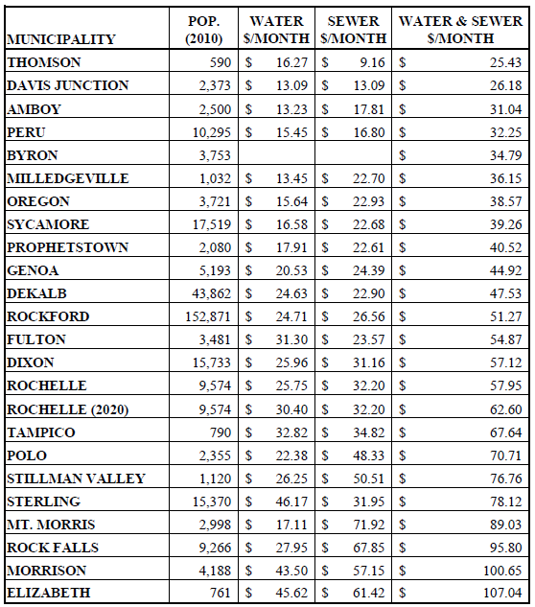
Water and Sewer Monthly Bill
Usage: 500 Cubic Feet/Month or
3,740 Gallons/Month

Slide 27
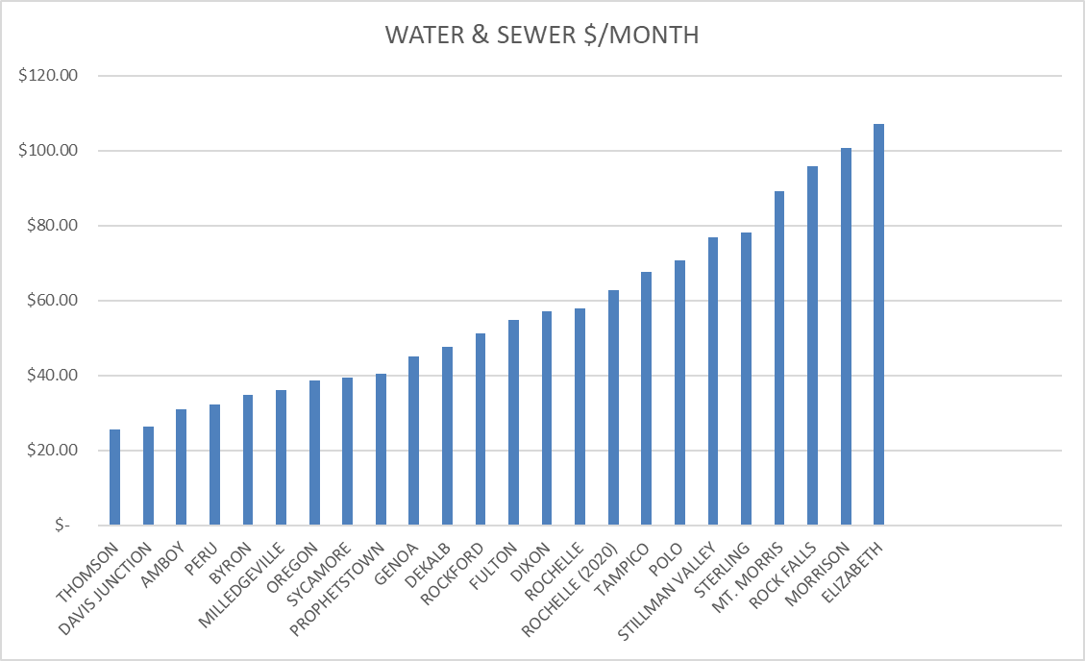
Water and Sewer Monthly Bill
Average: $56.68/Month

Slide 28
Cost Impact to Users
Residential (414 C.F./Month)

Slide 29
Cost Impact to Users
Rochelle Foods
Water Reclamation | CY 2019 | CY 2020 | CY 2021 | CY 2022 | CY 2023 | CY 2024
Total | $ 94,073.31 | $ 94,073.31 | $ 94,414.51 | $ 94,430.51 | $ 98,837.94 | $ 98,837.94
Increase ($) | $ - | $ - | $ 341.20 | $ 16.00 | $ 4,407.43 | $ -
Increase (%) | 0.0% | 0.0% | 0.4% | 0.0% | 4.67% | 0.0%
Water | CY 2019 | CY 2020 | CY 2021 | CY 2022 | CY 2023 | CY 2024
Total | $ 26,168.85 | $ 29,094.55 | $ 29,924.77 | $ 30,205.00 | $ 30,545.23 | $ 30,885.47
Increase ($) | $ - | $ 2,925.70 | $ 830.22 | $ 280.23 | $ 340.23 | $ 340.24
Increase (%) | 0.0% | 11.2% | 2.9% | 0.9% | 1.1% | 1.1%
Combined Water Rec/Water | CY 2019 | CY 2020 | CY 2021 | CY 2022 | CY 2023 | CY 2024
Total | $ 120,242.16 | $ 123,167.86 | $ 124,339.28 | $ 124,635.51 | $ 129,383.17 | $ 129,723.41
Increase ($) | $ - | $ 2,925.70 | $ 1,171.42 | $ 296.23 | $ 4,747.66 | $ 340.24
Increase (%) | 0.0% | 2.4% | 1.0% | 0.2% | 3.8% | 0.3%
Water Reclamation Usage: | 1,626,458 C.F./Month
Water Usage: | 2,321,000 C.F./Month

Slide 30
Cost Impact to Users
CHS (4,201,000 C.F./Month)
Water | CY 2019 | CY 2020 | CY 2021 | CY 2022 | CY 2023 | CY 2024
Average Monthly Bill | $ 45,902.71 | $ 50,332.41 | $ 51,162.63 | $ 51,442.86 | $ 51,783.09 | $ 52,123.33
Increase ($) | $ - | $ 4,429.70 | $ 830.22 | $ 280.23 | $ 340.23 | $ 340.24
Increase (%) | 0.0% | 9.7% | 1.6% | 0.5% | 0.7% | 0.7%

Slide 31
Cost Impact to Users
Creston (281,400 C.F./Month)

