Slide 1

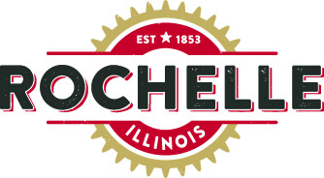
Rochelle’s Industrial Pretreatment Program
Potential Changes on the Horizon
Nichole Schaeffer, PE, BCEE
Rochelle City Council Meeting – April 12, 2021
Notes:
Working with Adam Lanning and Sharon Hawkins since 2018. Adam asked me here today to talk about what Federal mandates that may be coming and how the City can get ready

Slide 2
Objectives for Today
New Industries found in Industrial User Survey
Why to Update your Sewer Use and Pretreatment Ordinance
Fats, Oils, and Grease (FOG) Abatement
What is on the Horizon for RMU Pretreatment Program
Purpose of Industrial Pretreatment Program

Slide 3
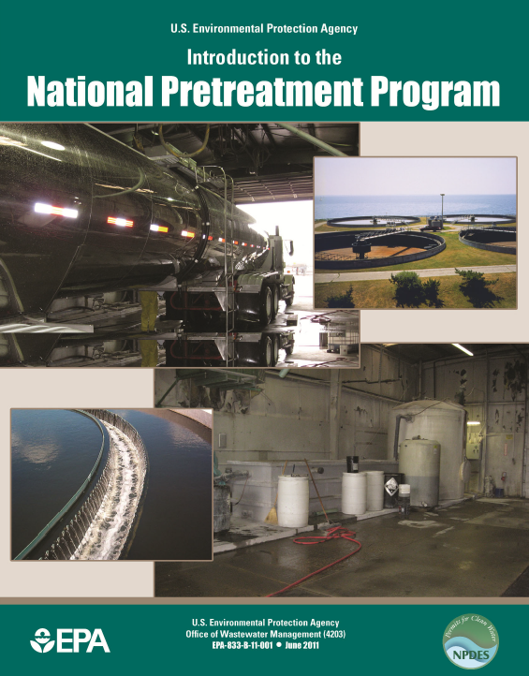

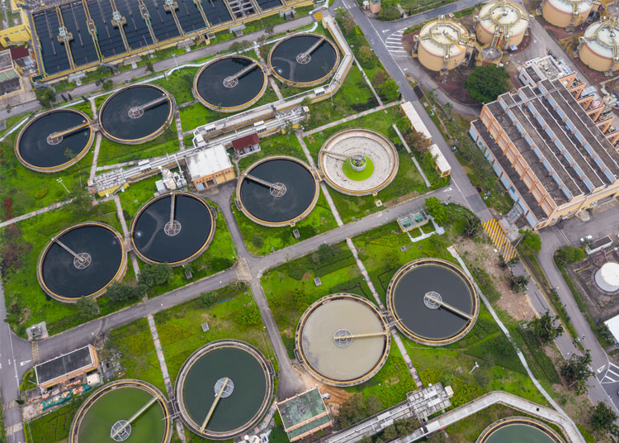
What is Pretreatment?
Why do We need it?
16,000+ POTWs in the US*
Treating 32 Billion GPD of wastewater*
~1,600 POTWs with approved PT Programs
~60,000 Significant Industrial Users (SIU) discharging to those POTW (2012)
CWA
NPDES Program
National PT Program
*Data from U.S. Environmental Protection Agency, Clean Water Needs Survey 2008 Report to Congress (2008).
Least commonly known but the longest running and most successful USEPA Program
Notes:
PT is not as commonly known as other EPA progs (RCRA or Superfund)

Slide 4
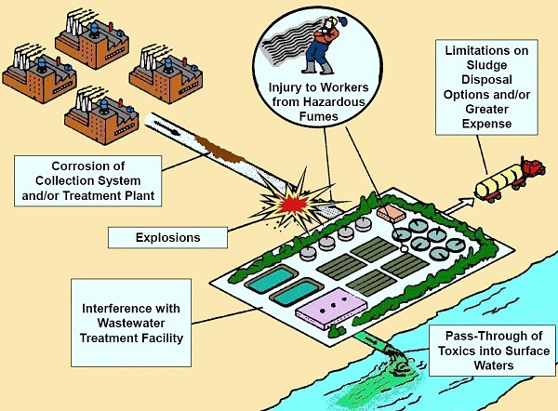
Purpose of the Pretreatment Program
EPA Created 1970
Clean Water Act 1972
PT Regs Promulgated 1978
You have the backing of the USEPA under the 40 CFR 403 regulations of the National Pretreatment Program
Prevent Interference & Pass Through
Notes:
Rochelle doesn’t yet land apply the biosolids but is looking to do so in the future.

Slide 5
Who is regulated by the Pretreatment Program?
Categorical Industrial User (CIU):
Industries regulated by one or more federal regulations through 40 CFR
Rochelle has 3 CIUs
Significant Industrial User (SIU):
Discharges or hauls an average of 25,000 gallons per day or more of process wastewater
Rochelle has 5 SIUs

Slide 6
What is potentially on the horizon for City of Rochelle?
Uncontrolled Industries
About 500 “rogue” CIU and SIU in IL alone
Bloomingdale and Woodstock received USEPA mandate to develop a formal program
USEPA states ~5,000 CIU and SIU outside of PT Programs in the U.S.
Adversely Impacting WWTPs
Industries have grown in Rochelle in the last 25 years
When collection system and WWTP is affected, USEPA takes notice
Formal Program Mandate?
Good chance Rochelle will get that mandate too
The potential to adversely impact the WWTP is taken into account
Sanitary Sewer Overflows are not allowed
3-CIU
5-SIU
18-Industrial Users
7-Surcharge Users
Restaurants with Grease issues
Protect the WWTP
Protect your Investment

Slide 7
Sewer Use & Pretreatment Ordinance (SUO)
SUO: A legal mechanism implemented by a local government entity that establishes requirements for the discharge of pollutants into a POTW.
Legal authority for the program
Food Service Establishments – FOG
Violations & Enforcement
Local Limits
Hauled Waste Acceptance
Prohibited Discharge Limitations
Provides the legal authority
25 years of updates
Robust language prevents Challenges
Rochelle Sewer Use and Pretreatment Ordinance was last published in the 1996 and not updated since
Notes:
Legal Authority - Key
Industries can Challenge

Slide 8
Core Pretreatment Components
Sewer Use and PT Ordinance
Update IU Discharge Permits
Local Limits
Update with current language that would be approved by USEPA
Permits should reflect the updated ordinance language and include the appropriate categorical effluent standards
Technically based: LL are re-evaluated after a major WWTP upgrade
Formal Programs must reevaluate every 5 years with the NPDES Permit Cycle
25 years of updates would be included
Rochelle has real industry that are major contributors of waste loading
Protect the WWTP
Protect your Investment

Slide 9
Core Pretreatment Components
What a PT Program Is:
This is not:
To beat up the industries – they expect regulations (RCRA, OSHA, Air Permitting), this is no different
Fair and equitable to Residential rate payer
A cooperative relationship with the Industries
Protects the investment put into the WWTP
Holds the Industries accountable

Slide 10
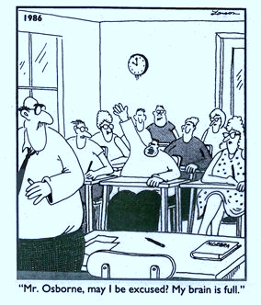
THANK YOU!

